Slide 1
CS 295B/CS 395B Systems for Knowledge Discovery
Sound Data Collection

Slide 2
What is data collection?

Slide 3
What is soundness?

Slide 4
How do we establish soundness?

Slide 5
Types of semantics

Slide 6
How to read denotational semantics

Slide 7
AI → PL
Both papers feature techniques from AI
PADS: Structure Discovery
FlashFill: Versions Space Algebras

Slide 8
Context: PADS project

Slide 9
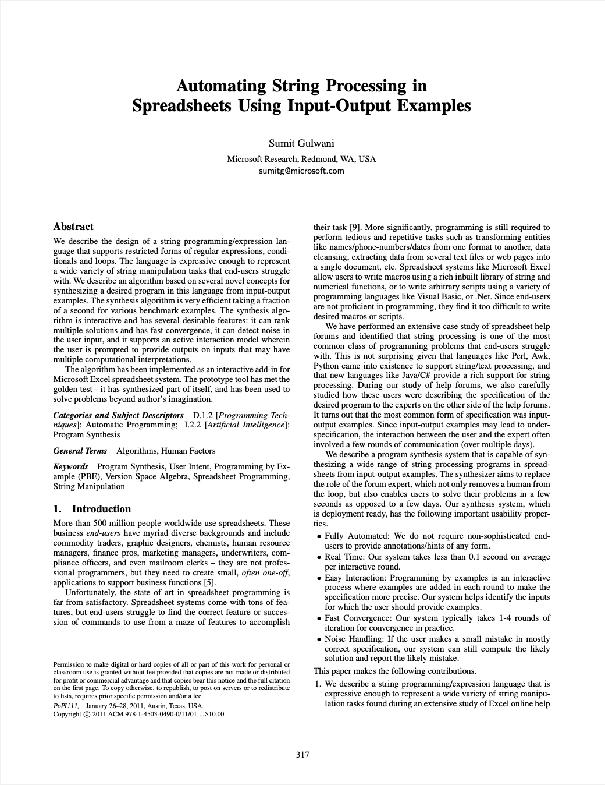
Context: FlashFill
POPL 2011
Test of Time Award: 2021
Why?

Slide 10
Context: FlashFill
First

